Slide 1
I (can’t stop killing my plants) oT
Justine Cocchi
Notes:
Survey the room

Slide 2

The Problem

Slide 3
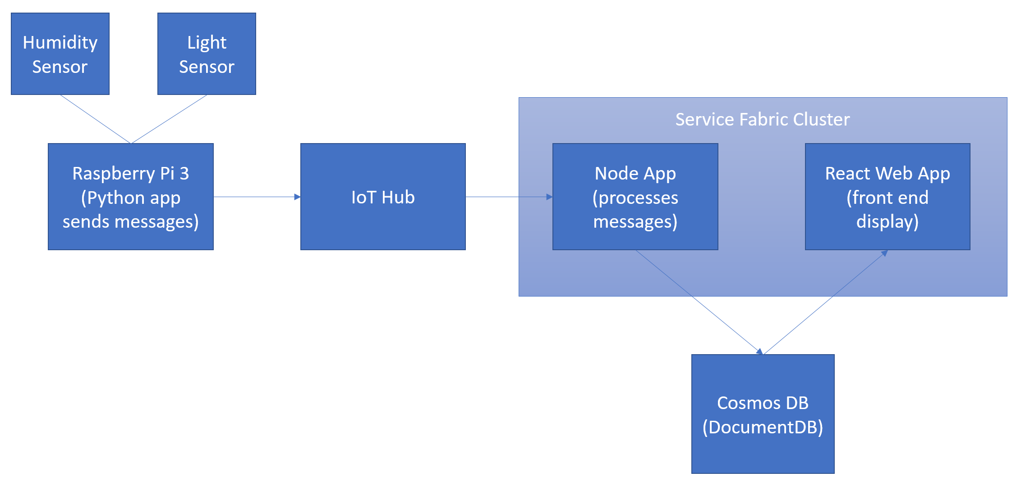
System Architecture

Slide 4
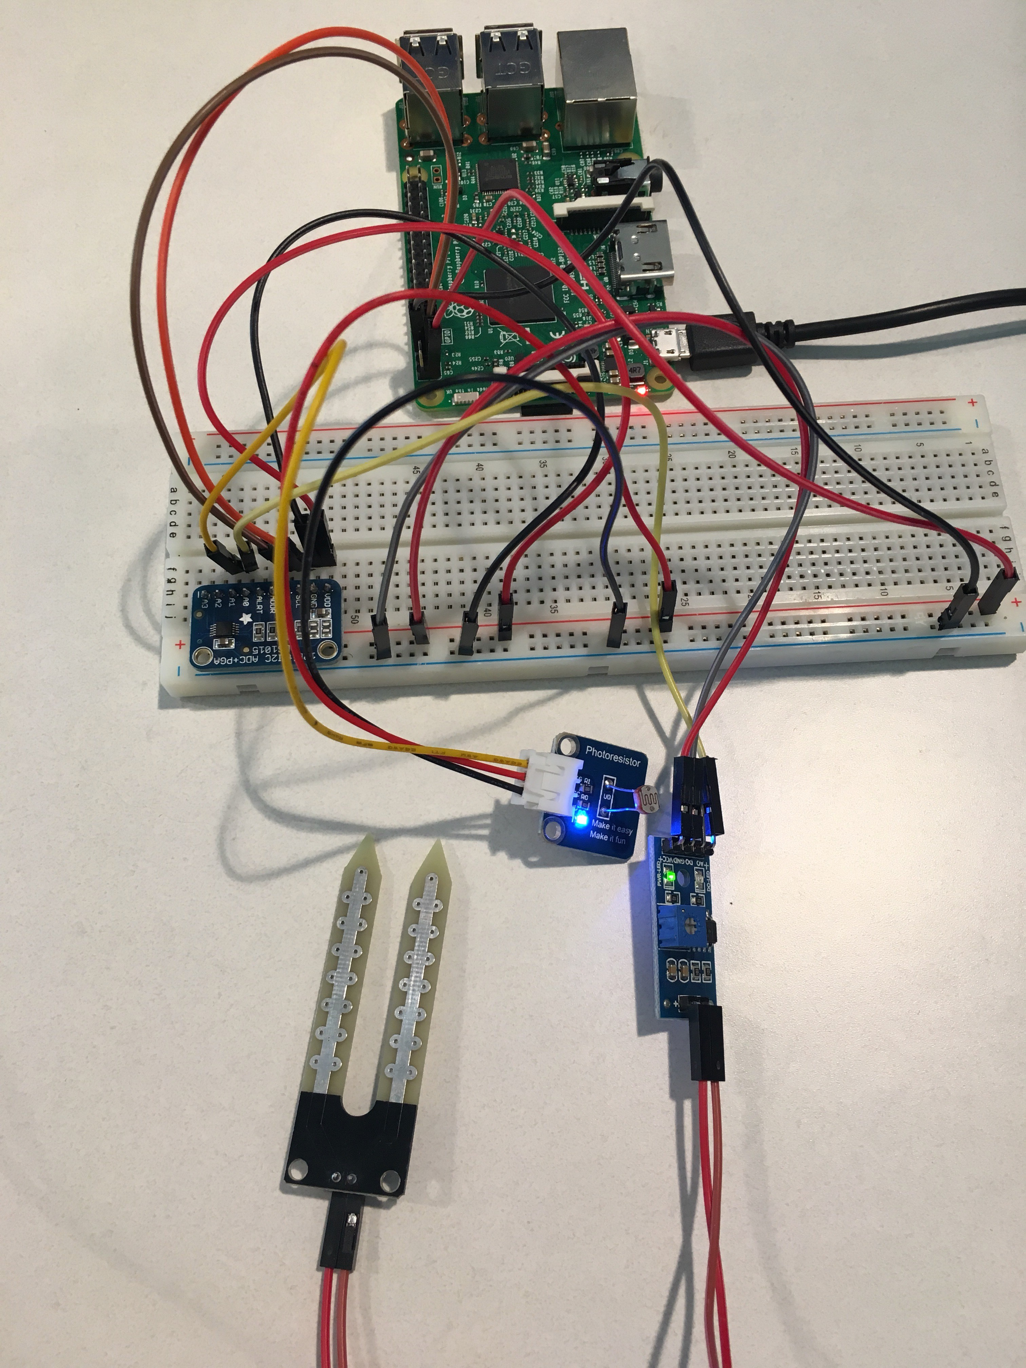
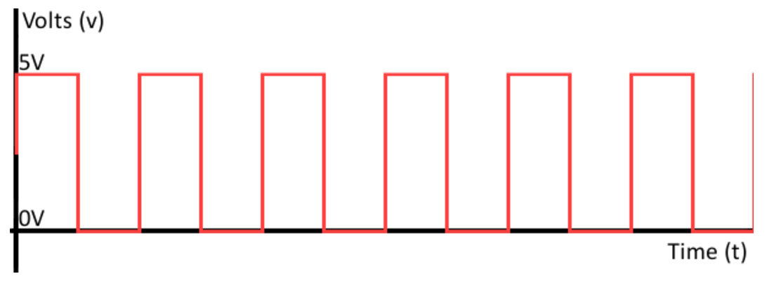
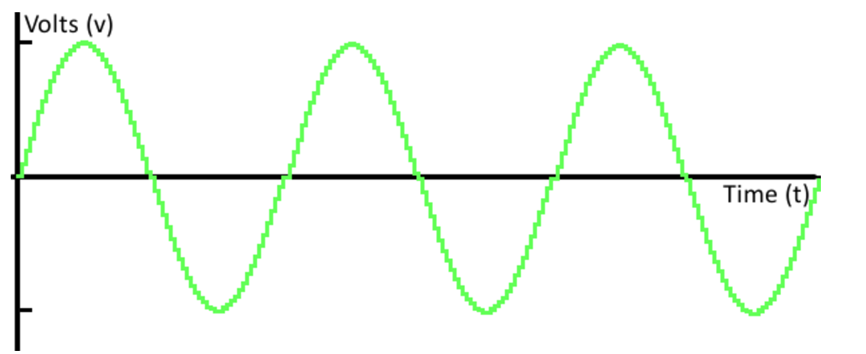
Analog Input to Raspberry Pi
Raspberry Pi doesn’t have native support for analog inputs
Used Adafruit’s ADS 1015 ADC
I2C connection
12 bit precision

Slide 5
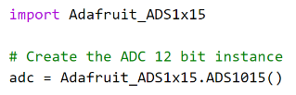
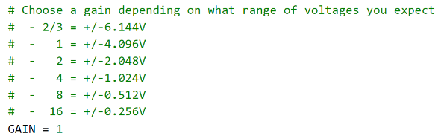
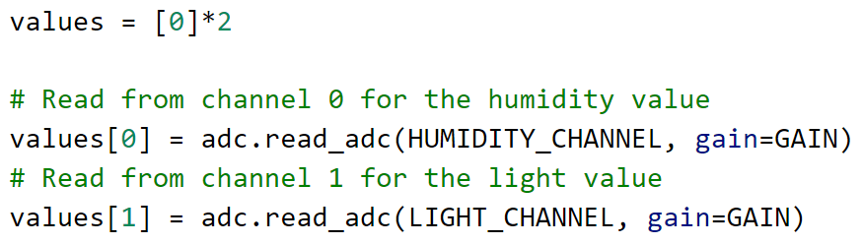
Reading the Sensor Data
Pip install Adafruit_ADS1x15
(Works with Python 2 and 3)
Import library & create instance
Set the gain
Read values from each channel

Slide 6

Let’s see it in action!

Slide 7
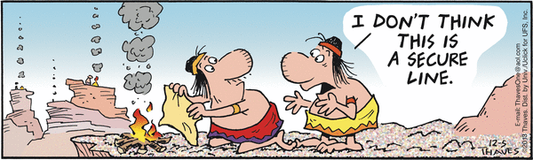
Sending a Message to IoT Hub
Azure IoT Hub SDK for Python is a wrapper on top of the SDK for C
SDK for C is brought in as a Git submodule
Need to build the C binaries before using the Python SDK
Used the MQTT messaging protocol

Slide 8

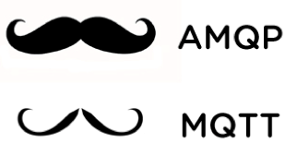
Why Message Queue Telemetry Transport (MQTT)?
Lightweight publish and subscribe messaging
Good for embedded systems
Low power draw
Low bandwidth
High latency

Slide 9
Let’s see it in action again!

Slide 10
Receiving Messages & Displaying Data
IoT Hub creates built in Event Hub for receiving/ processing messages
Separate, containerized app to receive all messages and write the data to CosmosDB
Website built with React displays an embedded PowerBI visualization

Slide 11
Last time!

Slide 12
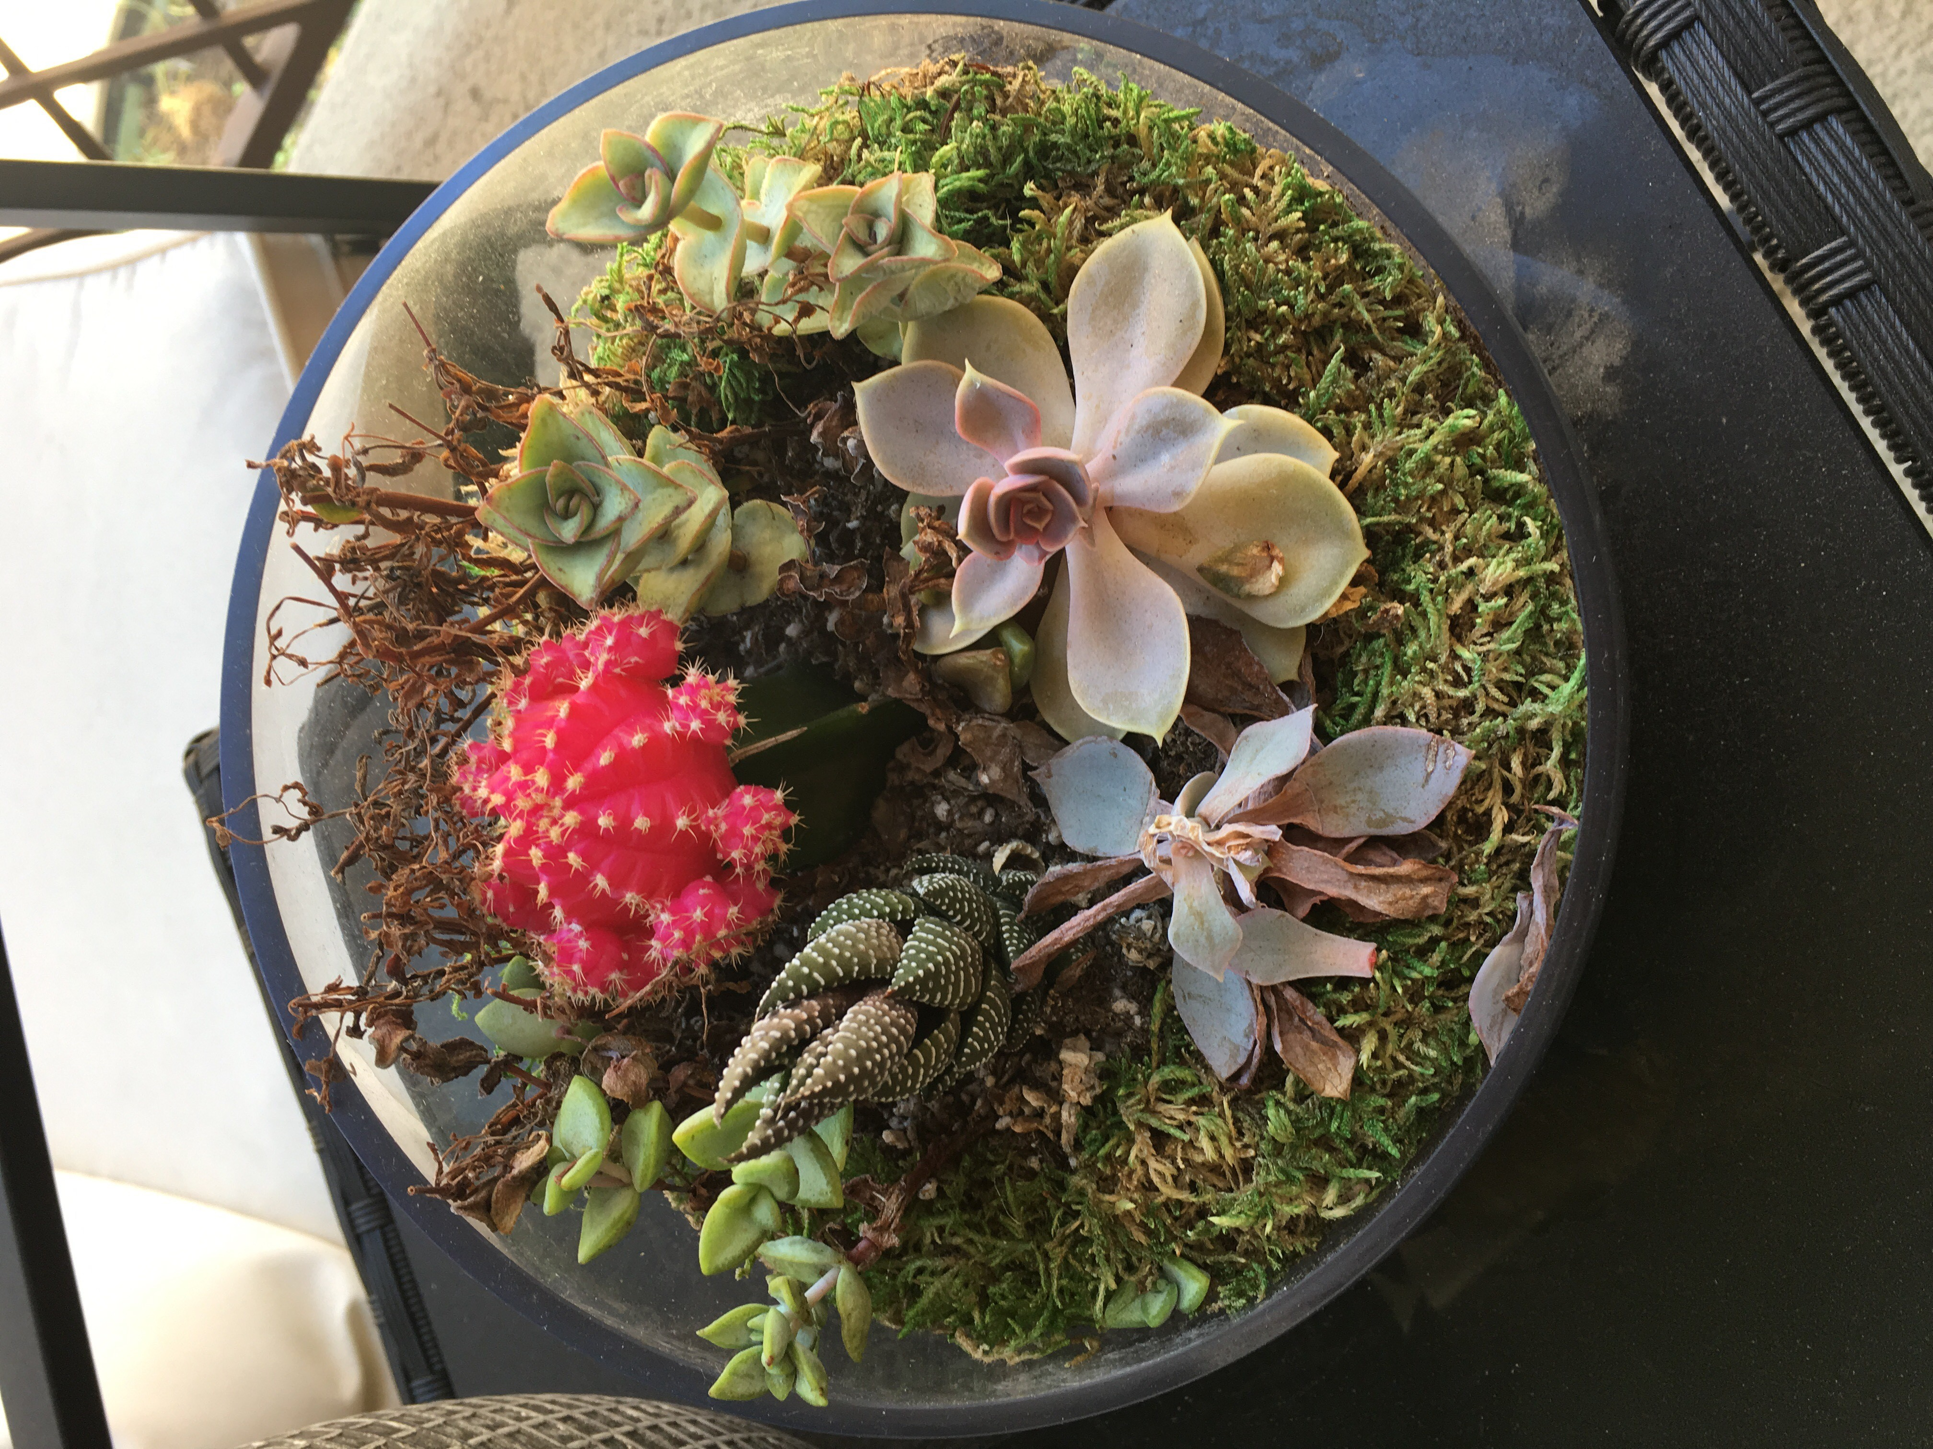
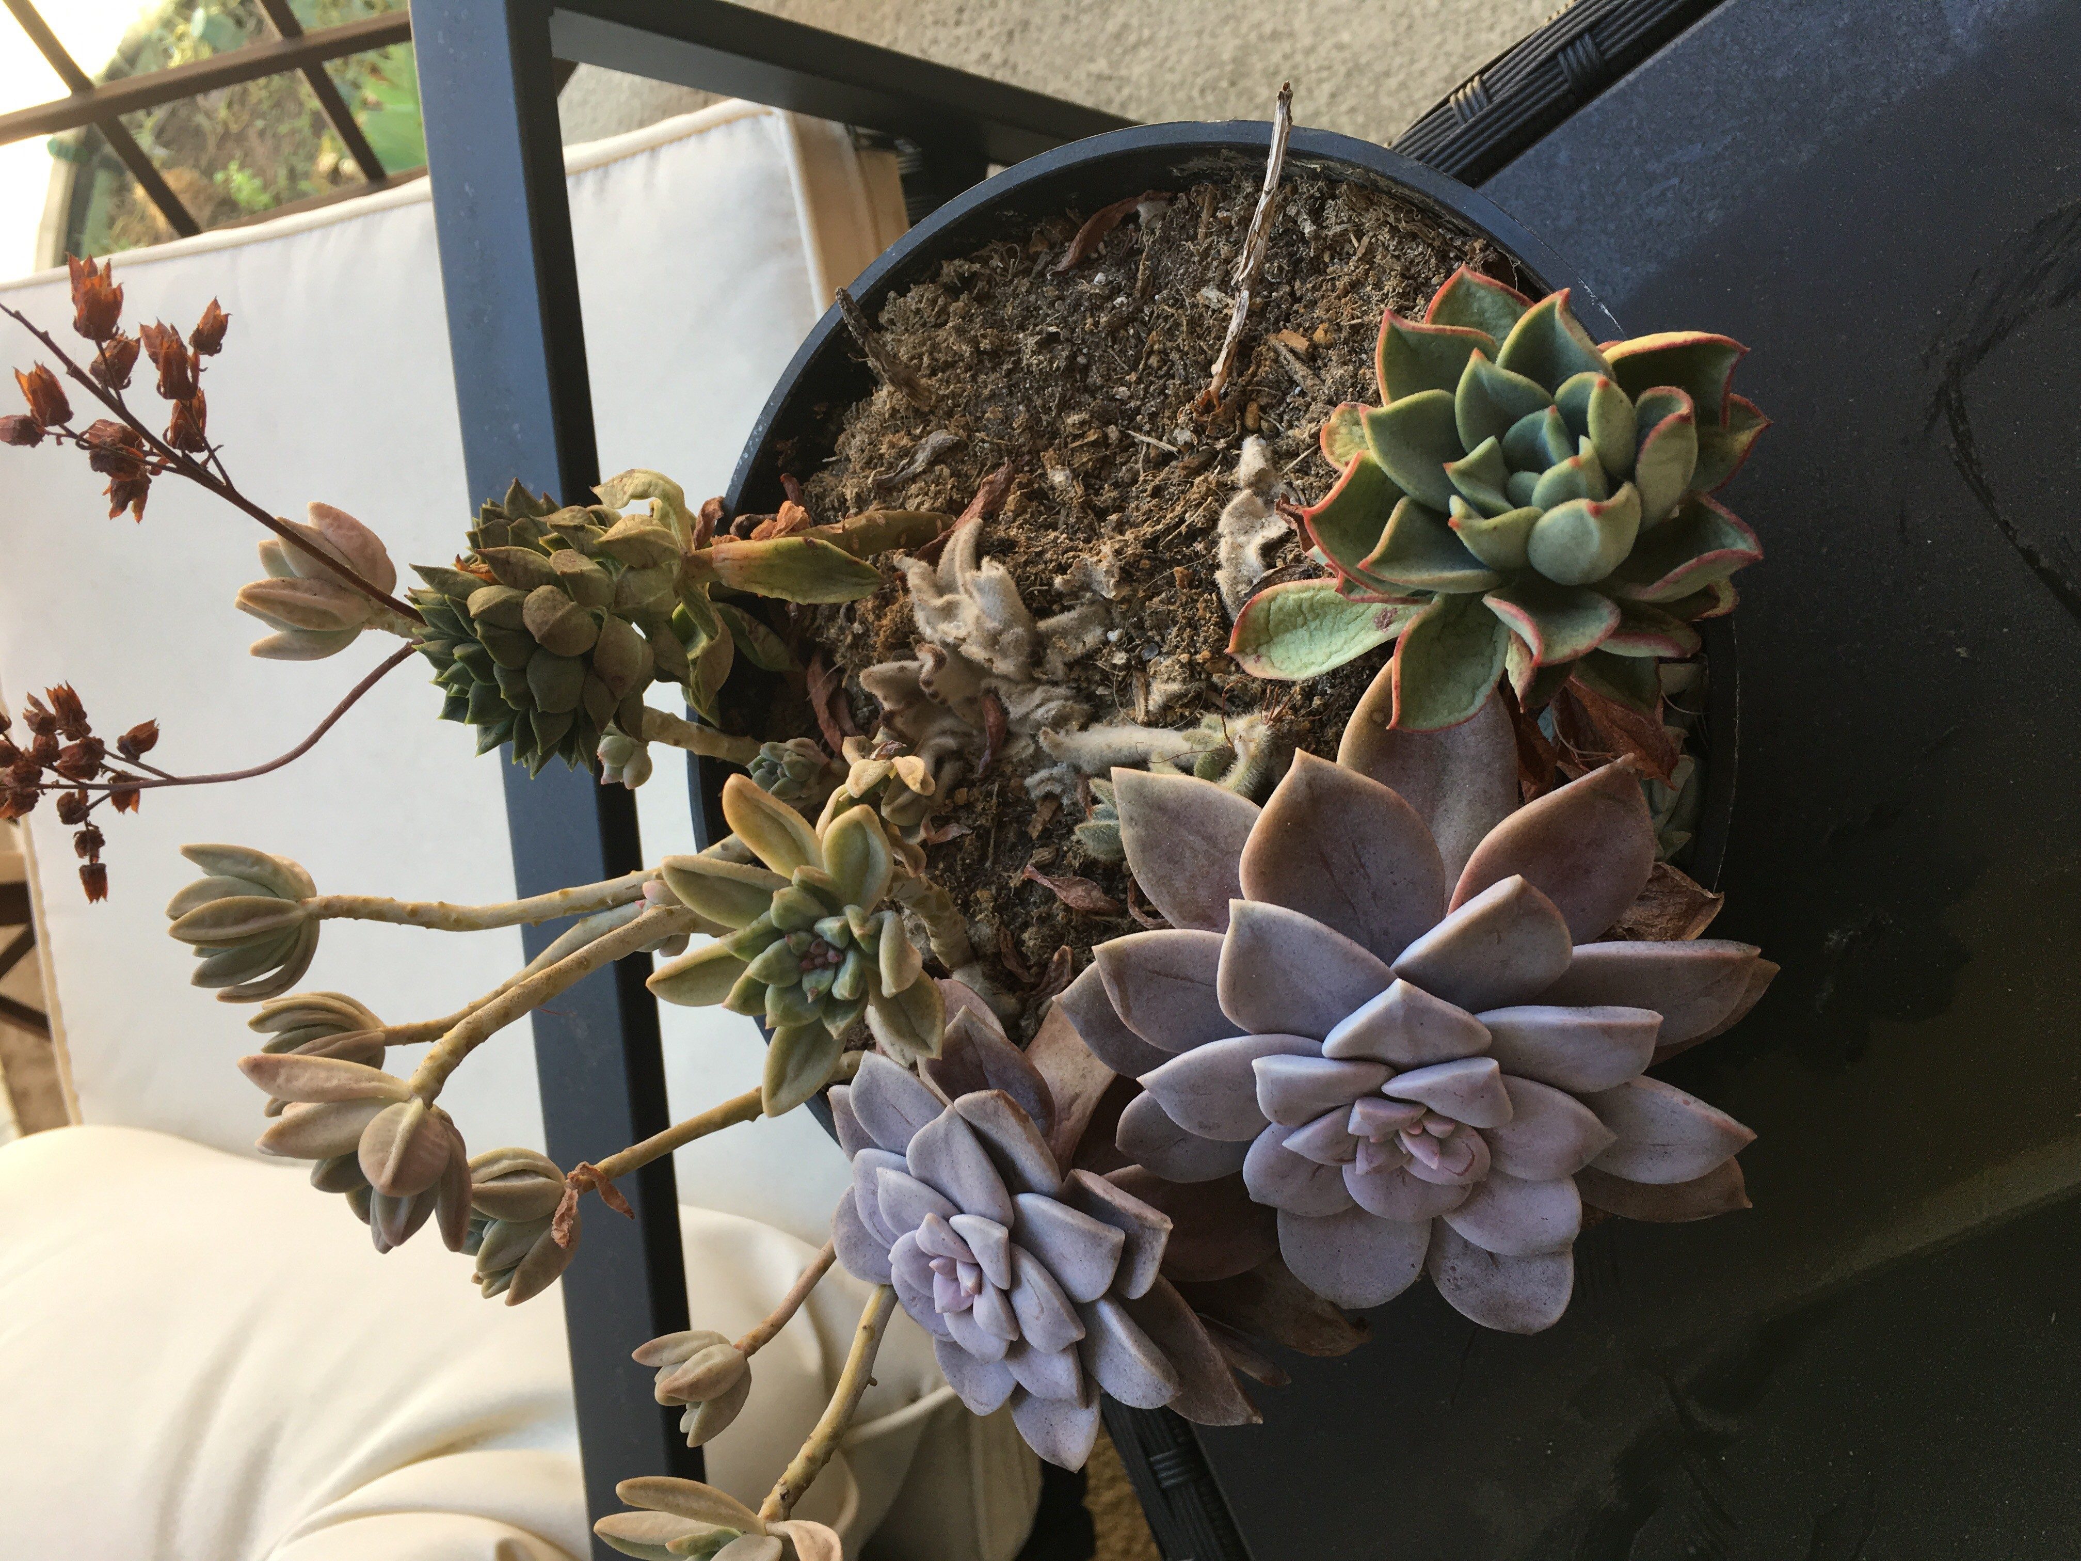
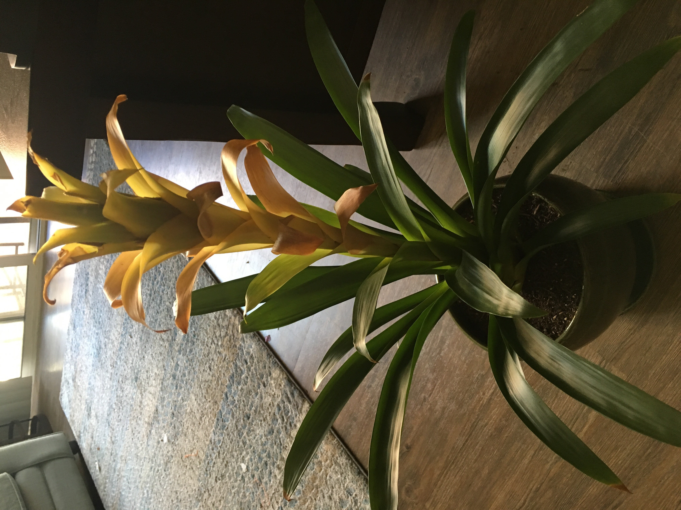
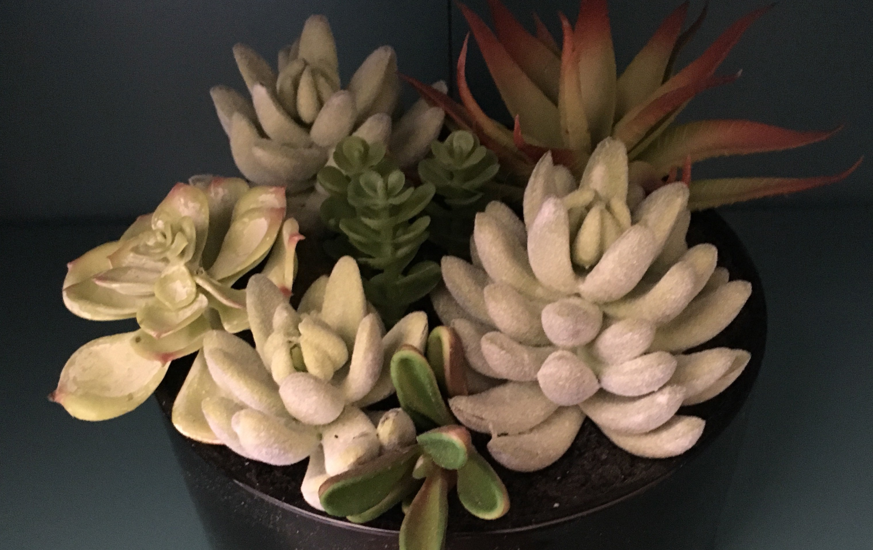
The Final Results

Slide 13
Questions?
Github.com/Azure/azure-iot-sdk-python
Github.com/jcocchi/HumiditySensor
Github.com/jcocchi/IoTPlantWatering
@justinecocchi
Justine.Cocchi@Microsoft.com

